Slide 1
SPIN/Promela
CSE 715 By Bharat Jayaraman
By Vineet Suresh Kothari and Aditya Bansal

Slide 2
Model checking
Model checking is an automatic verification technique for finite state concurrent systems.
Specifications are written in propositional temporal logic.
linear temporal logic is a modal temporal logic with modalities referring to time.
Verification procedure is an exhaustive search of the state space of the design.
Advantages of Model Checking:-
Fast
No Proofs
Counter Examples
No problem with partial

Slide 3
Model Checking in Practice
System behaviour: what is possible in our model?
We will use the language Promela to specify behaviour
Process Meta Language
Similar to C
Property specification: what are we checking for?
We will use the system Spin to check properties
● Simple Promela Interpreter
● Command-line and graphical user interfaces (XSpin)
Spin takes Promela specifications for the model and for properties.
● Can generate Promela property specifications from LTL
● Generates automata from Promela code
● Uses automata to check for language emptiness and intersection

Slide 4
Promela: Process Meta Language
Processes
Communicating over channels and shared variables
Processes execute asynchronously
Processes are global objects that represent the concurrent entities of the system. Message channels and variables can be declared either globally or locally within a process
Key Concepts
Processes
Message channels
Shared Variables
Models are required to be bounded and have only countably many distinct behaviors
Notes:
PROMELA programs consist of processes, message channels, and variables
Processes are global objects that represent the concurrent entities of the distributed system. Message channels and variables can be declared either globally or locally within a process. Processes specify behavior, channels and global variables define the environment in which the processes run.

Slide 5
Promela: Process Meta Language
About
Verification/Simulation modelling language
Abstraction of protocols for distributed systems basically
Ignore details unrelated to process interactions
SPIN - used to verify behaviour modelled in Promela
Notes:
PROMELA programs consist of processes, message channels, and variables
Processes are global objects that represent the concurrent entities of the distributed system. Message channels and variables can be declared either globally or locally within a process. Processes specify behavior, channels and global variables define the environment in which the processes run.

Slide 6
Promela Data Types
Basic types
bit, bool 1-bit, unsigned
byte 8-bit, unsigned
short 16-bit, signed
int 32-bit, signed
We also have a special type called mtype that allows symbolic constants mtype = {SEND, RECV};
Variables can be declared as arrays, e.g., byte state[N] state[0] = state[3 * i] + 5 * state[7/j];
Multi-dimensional arrays can be defined indirectly with
the help of the typedef construct.

Slide 7
More…
Operators and assignments: mostly like C or Java
define statements work as in C
#define N 10
#define sum(a,b) ((a)+(b)
The printf statement works as in C
PROMELA has a skip statement: increases the instruction pointer but does nothing else

Slide 8
Processes in Promela
Model checking is typically used for checking
– temporal properties (such as LTL formulae)
– correctness of dynamic systems
So processes are central to Promela:
active proctype HelloWorld ()
{ /* process code block (this is a comment) */ printf(“hello world\n”); }
Processes are execution threads (not functions!)
– Within a process block, code runs in order
– But different processes run in any order (interleaved)
– Processes marked active are started at runtime; others can be started with the run command.

Slide 9
Promela Process Type
Variable/message channel can only be changed/inspected by processes.
[proctype….run...]
proctype <name>( <formal parameters> ) { <body> }
run <name>(<actual parameter>)
[active proctype….]
We may declare a process using proctype and simultaneously launch it using active active proctype P() { ... } active proctype Q() { ... }

Slide 10
Example program
byte state = 0;
proctype A()
{
state = state + 10
}
active proctype B()
{
state = state + 20
}
init
{ run A();
}
run can be used anywhere.
runA() needed to run this process.
run() not required because of active keyword.

Slide 11
Guarding in Promela
The guard is a boolean expression that determines which statement will be executed.
If there is a choice, one is picked non-deterministically.
If none are true, the process blocks (waits) until a guard becomes true (e.g. if another process changes a global variable).
The keyword else can be used as a guard that evaluates to true iff nothing else does (i.e. if the if would block).
Types of guarding syntax in Promela
if :: sequence [ :: sequence ]* fi
do :: sequence [ :: sequence ]* od
timeout
else
break
goto

Slide 12
Guarding in Promela
byte state = 1;
proctype A()
{ byte tmp;
(state==1) -> tmp = state; tmp = tmp+1; state = tmp
}
proctype B()
{ byte tmp;
(state==1) -> tmp = state; tmp = tmp-1; state = tmp
}
init
{ run A(); run B()
}
run can be used anywhere.
Guarding Condition

Slide 13
Guarding in Promela
if :: sequence [ :: sequence ]* fi
if
:: (a != b) -> ...
:: (a == b) -> ...
fi
do :: sequence [ :: sequence ]* od
{do
:: count++
:: count--
:: (count == 0) ->
break
od}
else - a system defined condition statement
if
:: a > b -> ...
:: a == b -> ...
:: else -> ... /* evaluates to: a < b */
fi

Slide 14
Guarding in Promela
timeout - a predefined, global, read-only, boolean variable.
Timeout is a predefined, global, read-only, boolean variable that is true in all global system states where no statement is executable in any active process, and otherwise is false.
A timeout used as a guard in a selection or repetition construct provides an escape from a system hang state. It allows a process to abort waiting for a condition that can no longer become true.
active proctype watchdog()
{ do
:: timeout -> guard!reset
od }
In Promela there is no restriction on the type of statement that can be used as a guard of an option sequence.
In Promela, executability is used as the basic mechanism for enforcing process synchronization, and it is not considered to be an error if statements occasionally block.

Slide 15
Control Flow: repetition
Control Flow: ‘goto’
byte count;
proctype updown()
{do
:: count = count + 1
:: count = count - 1
:: (count == 0) -> break
od}
Only one option can be selected for execution at a time.
Execution of the structure repeated after option completes.
break is used to terminate the repetition structure.
Another way to break the loop – goto statement. Example:
proctype gcd(int x, y)
{do
:: (x > y) -> x = x - y
:: (x < y) -> y = y - x
:: (x == y) -> goto done
od;
done:}
skip}

Slide 16
Interleaving
If you imagine a process as a (possibly infinite) sequence/trace of statements (e.g. obtained by loop unfolding), then the set of possible interleavings of several processes consists of all possible sequences of statements of any of those process.
Consider for example the processes:-
int i; proctype A() { i = 1; } proctype B() { i = 2; }
Then the possible interleavings are i = 1; i = 2 and i = 2; i = 1
This can be of course more complex, for instance in the presence of guarded statements: Then the next possible statements in an interleaving sequence are not necessarily those at the position of the next program counter, but only those that are allowed by the guard; consider for example the proctype
proctype B() { if :: i == 0 -> i = 2 :: else -> skip fi }
Then the possible interleavings (given A() as before) are i = 1; skip and i = 2; i = 1, so there is only one possible final value for i.
Indeed the notion of interleavings is crucial for Spin's view of concurrency. In a trace semantics, the set of possible traces of concurrent processes is the set of possible interleavings of the traces of the individual processes.

Slide 17
Atomic Operation
Atomic - for defining a fragment of code that is to be executed indivisibly.
Processes can run concurrently and need to be synchronized using atomic blocks in order to avoid concurrent update problems.
Atomic sequences can be used to reduce the complexity of a verification.
Example: atomic { tmp = b; b = a; a = tmp}
In the example, the values of two variables a and b are swapped in an uninterruptible sequence of statement executions. The execution of this sequence cannot be blocked, since all the statements it contains are always unconditionally executable.
Warning:

Slide 18
Warning
If an infinite loop is accidentally included in an atomic sequence, the verifier cannot always recognize the cycle.
In the default depth-first search mode, the occurrence of such an infinite cycle will ultimately lead to the depth limit being exceeded, which will truncate the loop, but likely the result will still be a notable increase of complexity in redundant states being repeatedly matched.
In general, make sure that do-loops included in atomic or d_step sequences terminate.
Therefore a non-deterministic selection cycle such as the one below should never be enclosed in an atomic sequence:
do // do not make this atomic
:: a++
:: break
od
In breadth-first search mode, though, this type of an infinite cycle will be detected.

Slide 19
Atomic Operations
byte state = 1;
proctype A()
{ atomic {
state = state+1
}
}
proctype B()
{ atomic {
state = state+2
}
}
init
{ run A(); run B()
}
Atomic will ensure that only one process change value of state at one time.

Slide 20
Inference of previous program
Is the output guranteed?
Value of state may be 0 or 1 depending on A or B executing first.
The other process get stuck forever
How is using atomic different from previous example
Atomic - important to reduce the complexity of verification models
Restricts interleaving

Slide 21
Outline of Verification Process
Objective: form one big automata,
– which Spin can use for verification.
Turn Promela code into automata.
Combine multiple automata,
– via asynchronous products.
Incorporate variable valuations,
– via automata expansions.
Incorporate never claims,
– via synchronous products.
The meaning of a Promela model (i.e. how it executes) can be understood from the automaton it describes.

Slide 22
Turn Promela into Automata
Code for each proctype describes a finite state automaton.
So a Promela model can be seen as a collection of automata running concurrently and interactively.
We shall show by examples how to construct the automaton described by each proctype. Roughly,
– Each location in the code becomes a state in the automaton; recall that a location can have one or more labels (e.g. init: )
– First location becomes the initial state
– Control-flow statements describe the transitions from the current state, and
– Basic statements label the transitions

Slide 23
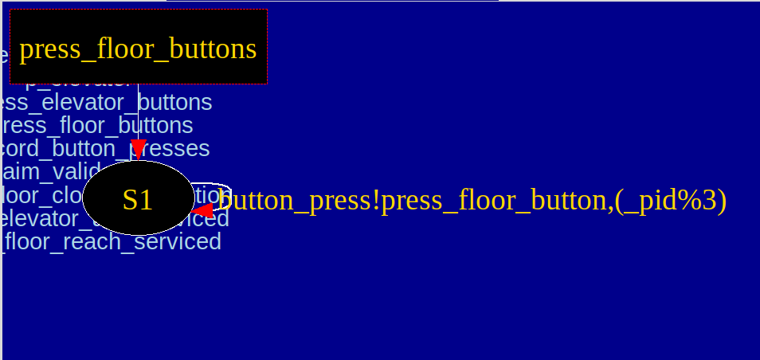
Example 1: Promela to Automata
103 active [3] proctype press_elevator_buttons()
104 {
105 start:
106 button_press!press_elevator_button(_pid % 3) -> goto start
107 }

Slide 24
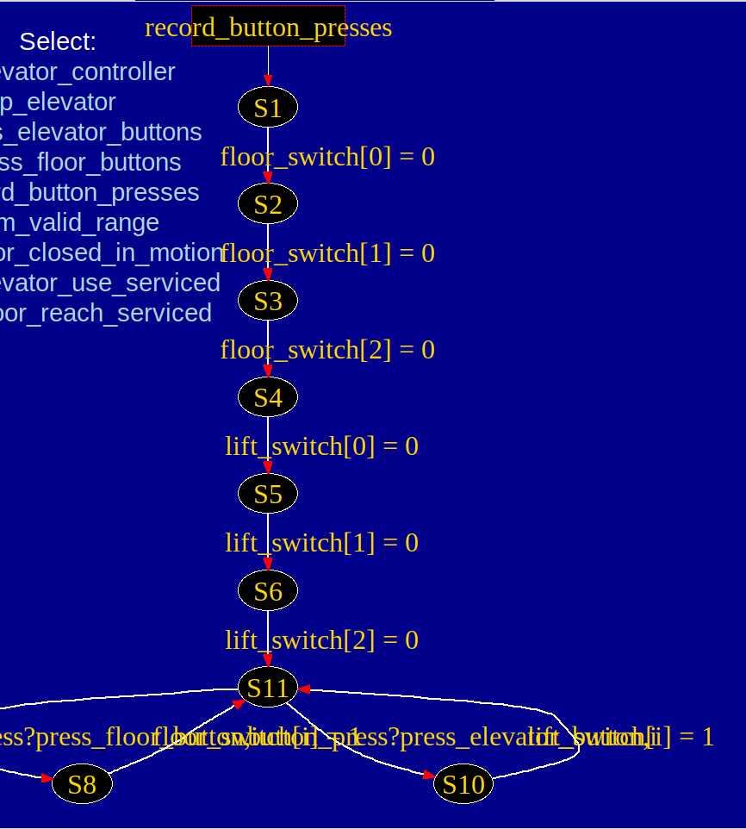
Example 2: Promela to Automata
active proctype record_button_presses()
118 {
119 byte i;
120 floor_switch[0] = 0; floor_switch[1] = 0;
floor_switch[2] = 0;
121 lift_switch[0] = 0; lift_switch[1] = 0;
lift_switch[2] = 0;
122
123 start:
124 if
125 :: button_press?press_floor_button(i) ->
floor_switch[i] = 1
126 :: button_press?press_elevator_button(i) ->
lift_switch[i] = 1
127 fi
128 goto start
129 }

Slide 25
Methods used in Verification Process

Slide 26
Assert
Assert - for stating simple safety properties.
An assert statement is similar to skip in the sense that it is always executable and has no other effect on the state of the system than to change the local control state of the process that executes it.
The assert statement takes any valid Promela expression as its argument. The expression is evaluated each time the statement is executed. If the expression evaluates to false (or, equivalently, to the integer value zero), an assertion violation is reported.
e.g.,
assert(x+1 != 2)
assert(y>2)
assert(false) – checks reachability of certain locations in proctype body

Slide 27
Verifying Global Properties
Assertions can be used to verify a property locally
– For example, place assert(MemReturned) at the end of the process to verify that the requested memory has been returned before the process ends.
Some properties depend on non-local behaviour of the model
– For example, that the system never enters illegal states
– or that it eventually enters the desired state
● Assertions alone are not sufficient for verifying these properties
● A more powerful method is to use “never claims”

Slide 28

Never Claim
•Declaration of a temporal claim that should never happen in the system being specified.
•Defined as a series of propositions, or boolean expressions, on the system state that must become true in the sequence specified for the behavior of interest to be matched.

Slide 29
Never Claim..
When generating a verifier, Spin creates one (active) process for the never claim declared
Verifier executes the never-claim process between every execution of other processes.
Verifier reports error if the never-claim process ends

Slide 30
LTL
ltl - linear time temporal logic formulae for specifying correctness requirements.
The easiest way to specify an LTL property is to specify it inline. The formula is specified globally (i.e., outside all proctype or init declarations) with the following syntax:
ltl [ name ] '{' formula '}'
ltl p1 { []<> p }
ltl p2 { always eventually p }
ltl p3 { eventually (a > b) implies len(q) == 0 }

Slide 31
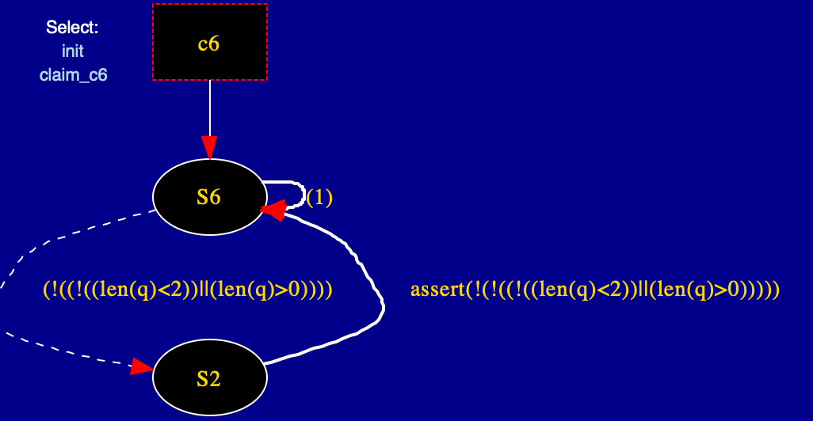
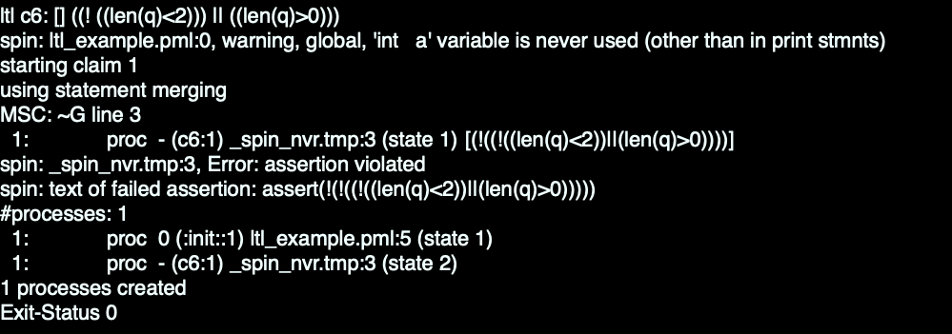
Example:-
1 chan q; int a;
2
3 ltl c6 { [] ( (len(q) < 2) -> (len(q) > 0) ) }
4
5 init { printf("hello world\n") }

Slide 32
Promela syntax for LTL
Grammar:
ltl ::= opd | ( ltl ) | ltl binop ltl | unop ltl
Operands (opd):
true, false, user-defined names starting with a lower-case letter,
or embedded expressions inside curly braces, e.g.,: { a+b>n }.
Unary Operators (unop):
[] (the temporal operator always)
<> (the temporal operator eventually)
! (the boolean operator for negation)
Binary Operators (binop):
U (the temporal operator strong until)
W (the temporal operator weak until (only when used in inline formula)
V (the dual of U): (p V q) means !(!p U !q))
&& (the boolean operator for logical and)
|| (the boolean operator for logical or)
/\ (alternative form of &&)
\/ (alternative form of ||)
-> (the boolean operator for logical implication)
<-> (the boolean operator for logical equivalence)

Slide 33
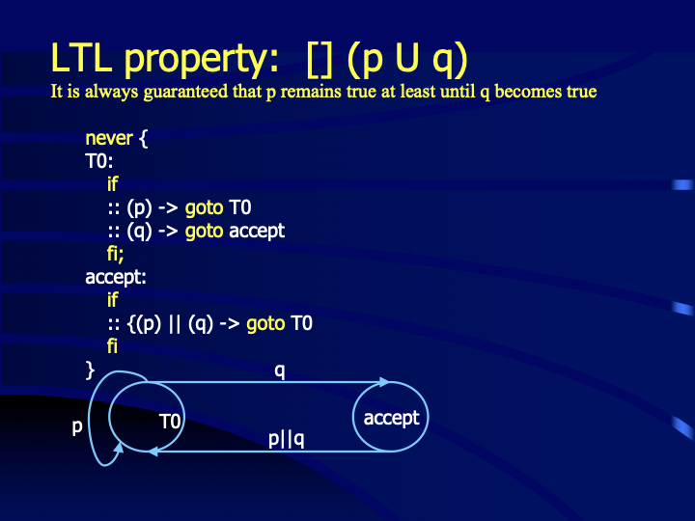

Slide 34
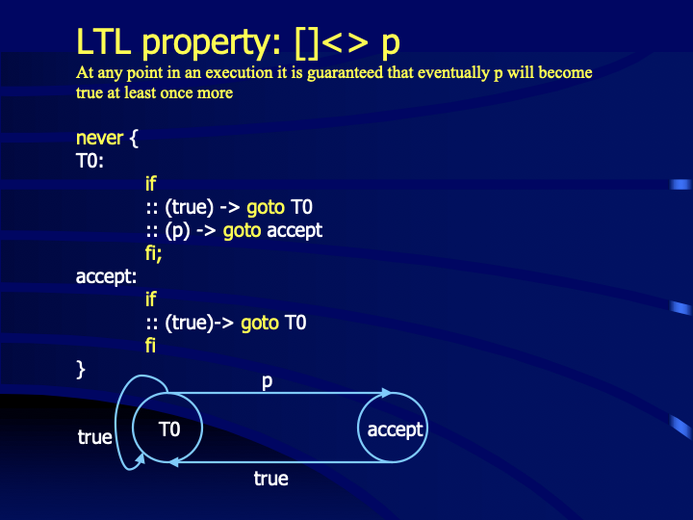

Slide 35
Verification in SPIN
A Promela specification defines a model, M i.e., a set of sequences.
The LTL formula specifies a set of behaviors, L, that must hold.
Correctness of the model requires that M ⊆ L.
SPIN checks that M ∩ L^{c} = {}, where L^{c} is the complement of L.
L^{c} is specified as a “never claim”.

Slide 36
Notes on Never Claims and LTL
Never claims (+ accept labels) are strictly more powerful than LTL formulae
– Properties specifiable in LTL can be specified using never claims
– but never claims can specify properties not specifiable in LTL
Code in never claims must be side-effect free; e.g. they are not allowed to modify variables.
The LTL operator next (X) is confusing – it is usually better to avoid it. (This is because if there are multiple processes, the next state will be a single step by any process, and X(p) means that p holds for all such immediately next states.)

Slide 37
Key things about Promela
-> and ; are both statement separators
No difference between conditions and statements
-> mean an INFORMAL way to declare causal relation
Smallest process init{skip}
A process can be terminated iff ALL THE PROCESSES IT HAS STARTED HAVE TERMINATED

Slide 38
Message Passing-Channels
Message channels are used to model the transfer of data from one process to another.
Channel declaration
chan qname = [1] of {short}
chan qname = [16] of {byte,int,chan,byte}
Sending messages (!)
qname!expr [sends the value of the expr to channel ‘qname’]
Sends message expr on channel qname
Basically appends to tail of the channel
Receiving messages (?)
qname?msg [retrieves it from the head of the channel, and stores it in the variable msg.]
retrieves message from head of the channel qname
Notes:
chan qname = [16] of {short} This declares a buffered channel that can store up to 16 messages of type short (capacity is 16 here).

Slide 39
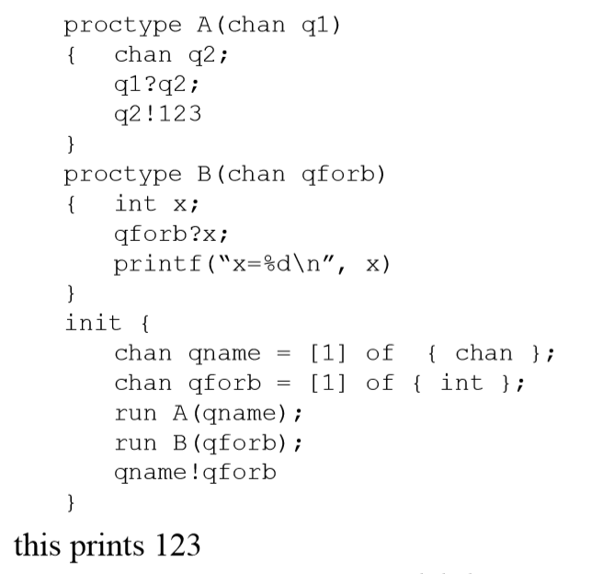
Message Passing in Promela
Input from channel q1
Output on
channel q2
Type of
value in
Channel
Run Processes
Concurrently
Size of
Channel
Buffer

Slide 40
Executability
Channel can be passed as parameters
Channels pass messages in FIFO order
Send message is executable iff the channel is not full
Similarly with receive, if the channel is non empty
If an non executable statement is encountered: nothing will happen.
Execution delayed until an execution statement is encountered.
Notes:
chan qname = [16] of {short} This declares a buffered channel that can store up to 16 messages of type short (capacity is 16 here).

Slide 41
Rendezvous
Channel of size 0 defines a rendezvous port e.g. chan port = [0] of {byte}
Message interactions via such rendezvous ports are by definition synchronous
Can be used by two processes for a synchronous handshake
No queueing
The first process blocks
Handshake occurs after the second process arrives

Slide 42
Alternating Bit Protocol
ABP is a simple network protocol operating at the data link layer that retransmits lost or corrupted messages.
Messages are sent from transmitter A to receiver B. Each message from A to B contains a data part and a one-bit sequence number, a value that is 0 or 1. B has two acknowledge characters that it can send to A: ACK0 and ACK1.
When A sends a message, it resends it continuously, with the same sequence number, until it receives an acknowledgment from B that contains the same sequence number. Then, A complements the sequence number and starts transmitting the next message.
When B receives a message that is not corrupted and has sequence number 0, it starts sending ACK0 and keeps doing so until it receives a valid message with number 1. Then it starts sending ACK1.

Slide 43

Alternating Bit Protocol
sender
receiver
sender
receiver
send pkt0
pkt0
send pkt0
pkt0
rcv pkt0
rcv pkt0
ack0
send ack0
ack0
send ack0
rcv ack0
rcv ack0
send pkt1
pkt1
send pkt1
pkt1
rcv pkt1
X
ack1
send ack1
loss
rcv ack1
send pkt0
pkt0
rcv pkt0
timeout
resend pkt1
ack0
send ack0
pkt1
rcv pkt1
ack1
send ack1
rcv ack1
send pkt0
pkt0
rcv pkt0
ack0
send ack0
(a) No packet loss
(b) Packet loss
Notes:
abp.pml

Slide 44
sender
receiver
sender
receiver
send pkt0
pkt0
send pkt0
pkt0
rcv pkt0
rcv pkt0
ack0
send ack0
send ack0
rcv ack0
ack0
send pkt1
pkt1
rcv ack0
rcv pkt1
send pkt1
pkt1
send ack1
rcv pkt1
ack1
send ack1
ack1
X
loss
timeout
resend pkt1
pkt1
rcv pkt1
timeout
resend pkt1
pkt1
rcv pkt1
rcv ack1
(detect duplicate)
(detect duplicate)
pkt0
send ack1
ack1
send ack1
rcv ack1
ack1
rcv ack1
rcv pkt0
send pkt0
pkt0
ack0
do nothing
rcv pkt0
ack0
send ack0
send pkt0
send ack0
(c) ACK loss
(d) premature timeout/
delayed ACK

Slide 45
Basically A should receive ack ‘b0’ for a message ‘a0’ sent to B
and ack ‘b1’ for message ‘a1’.

Slide 46
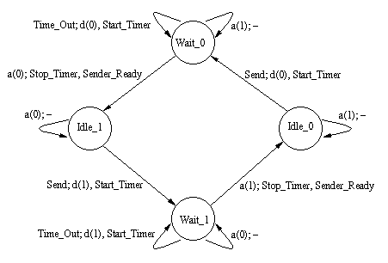
State diagram

Slide 47
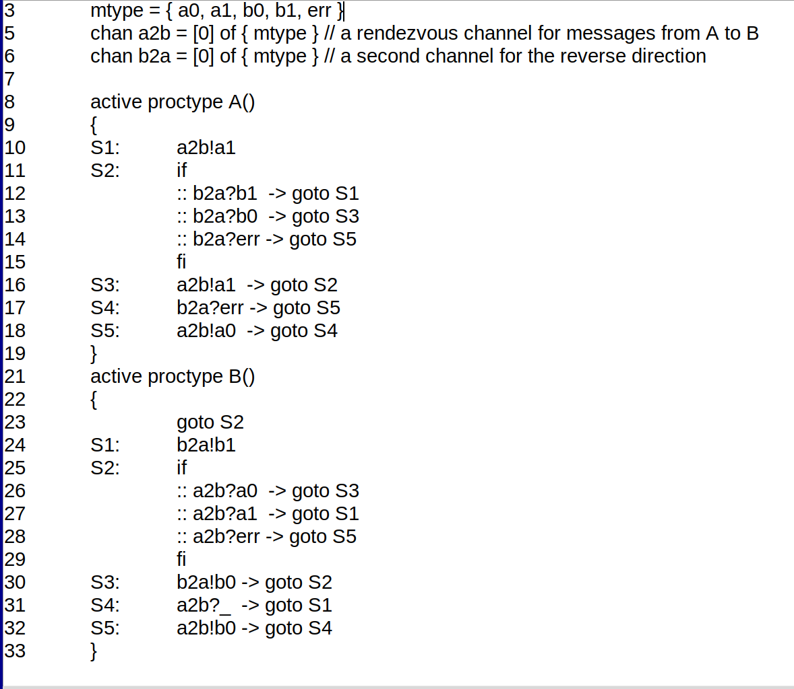
What is wrong with this?

Slide 48
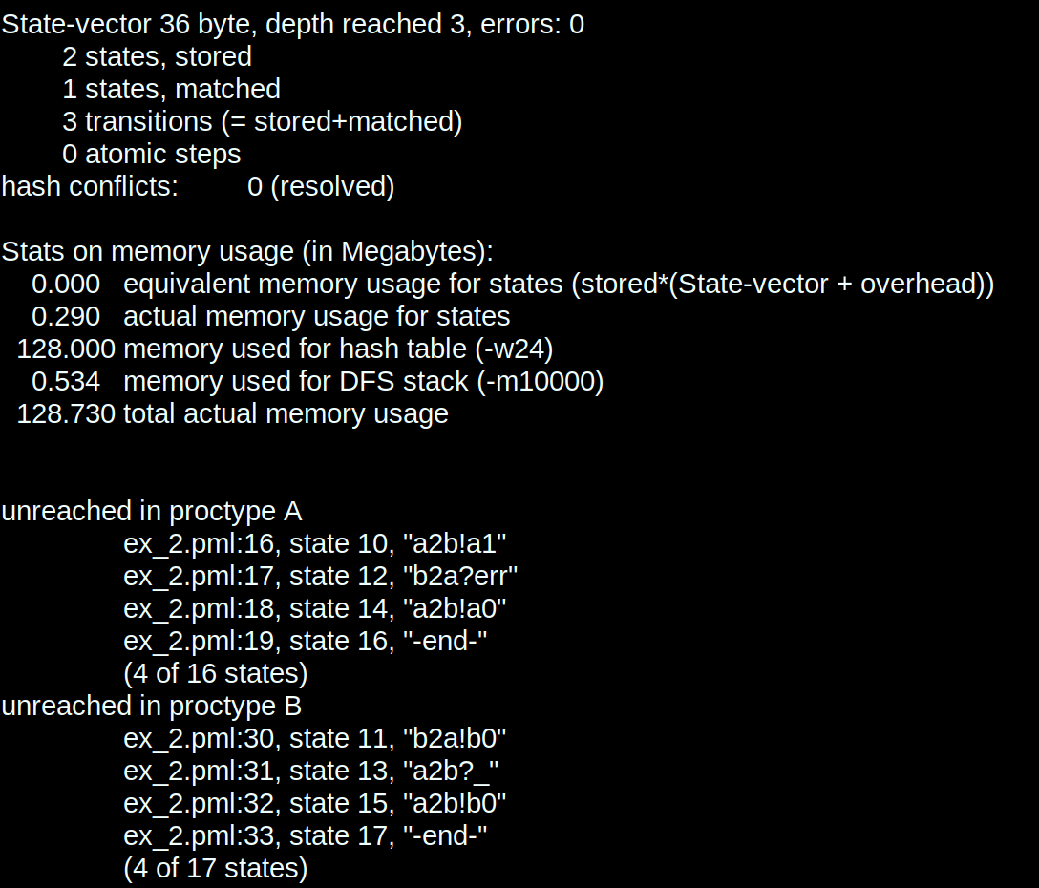
Verification in SPIN
Unreached state: where A sends B a0
Since the process is always active and never ending

Slide 49
States stored: the number of states visited in the search
States matched: The number of states revisited.

Slide 50
What is wrong with this?
If A receives ack ‘b1’ for msg ‘a1’, It goes back to state S1.
Sender/ Process A never checks for ack ‘b0’ if it sends ‘a0’

Slide 51
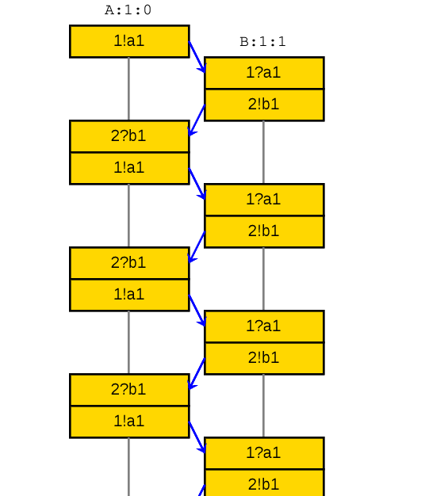
Message sequence charts
channel of A
channel of B
Remember:
! is for sending
A!msg1 - A sends msg1
? is for receiving
B?msg1 - A receives msg1

Slide 52
Message sequence charts
channel of A
A sends ‘a1’
channel of B
If A receives ‘b1’
sends ‘a1’ again
B sends ack ‘b1’

Slide 53
Promela Specification of ABP
51 init {
52 chan a2b = [2] of { bit };
53 chan b2a = [2] of { byte, bit };
54 atomic {
55 run A(a2b, b2a);
56 run B(b2a, a2b)
57 }
58 }
The definitions of the proctypes A and B
are given on the next slide.
Every message fetched by A is received error-free at least once and accepted at most once by B

Slide 54
1 #define MAX 4
2
3 proctype A(chan inp, out) {
4 byte mt; /* message data */
5 bit vr;
6 S1: mt = (mt+1)%MAX;
7 out!mt,1;
8 goto S2;
9 S2: inp?vr;
10 if
11 :: (vr == 1) -> goto S1
12 :: (vr == 0) -> goto S3
13 :: printf("MSC: AERROR1\n") -> goto S5
14 fi;
15 S3: out!mt,1;
16 goto S2;
17 S4: inp?vr;
18 if
19 :: goto S1
20 :: printf("MSC: AERROR2\n"); goto S5
21 fi;
22 S5: out!mt,0;
23 goto S4
24 }
26 proctype B(chan inp, out) {
27 byte mr, lmr;
28 bit ar;
29 goto S2; /* initial state */
30 S1: assert(mr == (lmr+1)%MAX);
31 lmr = mr;
32 out!1;
33 goto S2;
34 S2: inp?mr,ar;
35 if
36 :: (ar == 1) -> goto S1
37 :: (ar == 0) -> goto S3
38 :: printf("MSC: ERROR1\n"); goto S5
39 fi;
40 S3: out!1;
41 goto S2;
42 S4: inp?mr,ar;
43 if
44 :: goto S1
45 :: printf("MSC: ERROR2\n"); goto S5
46 fi;
47 S5: out!0;
48 goto S4
49 }

Slide 55
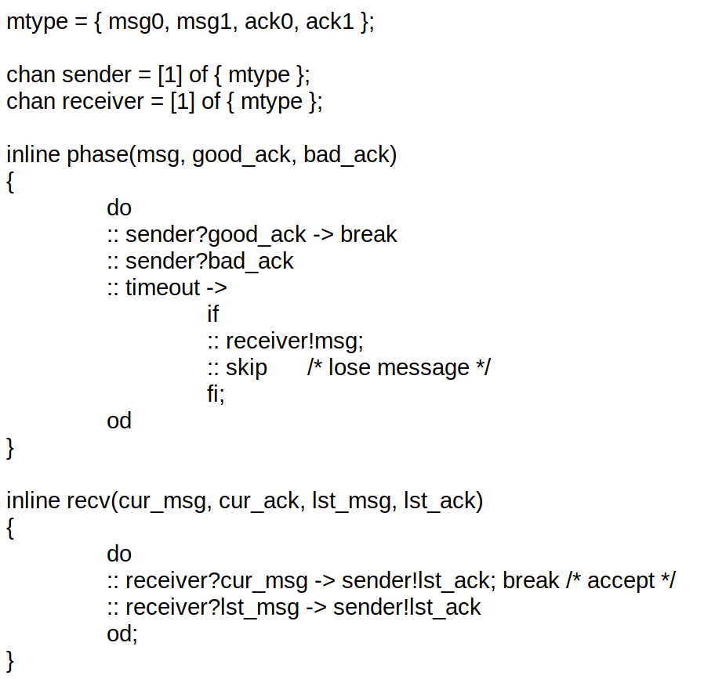
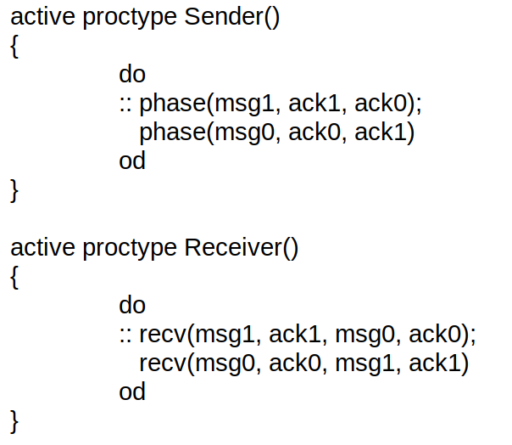
Correct implementation

Slide 56
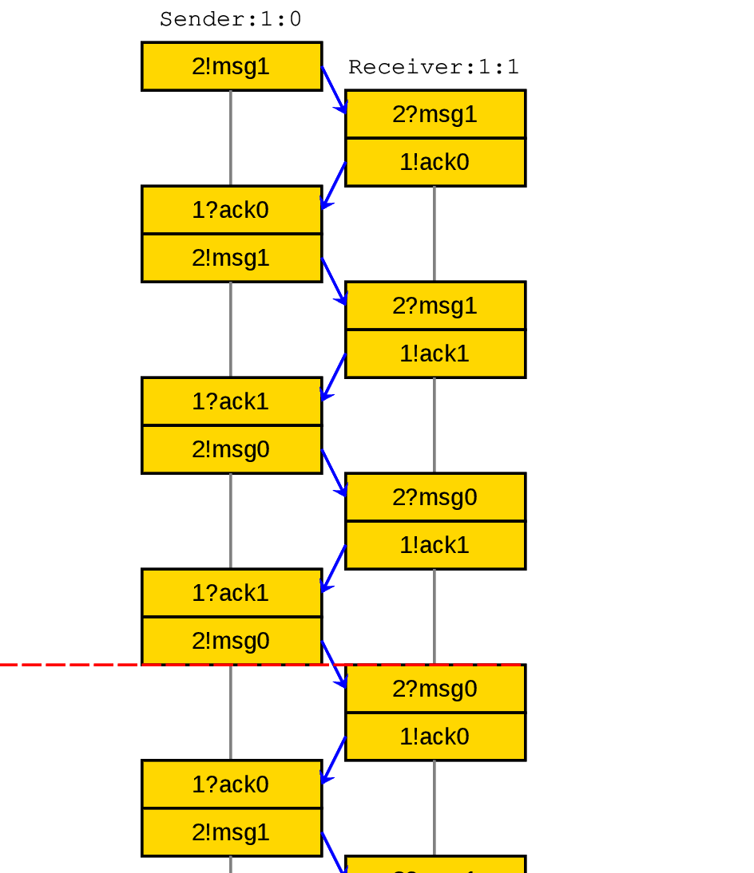
Message simulation charts
Wrong ack ‘ack0’ received by sender A for message ‘msg1’
So msg1 is sent again by sender A, until it get the correct ack or timesout

Slide 57
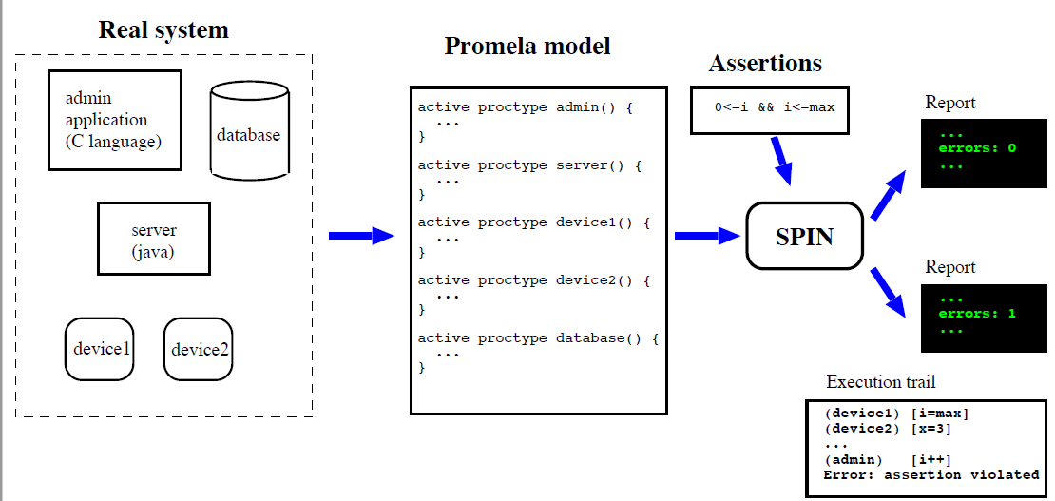
SPIN Model Checker
SPIN performs exhaustive search for errors

Slide 58
Overview..
Developed at Bell Labs during 1980’s and ’90s. Written in ANSI standard C, and is a portable, open-source system.
https://spinroot.com
2002 ACM software system award for 2001

Slide 59
SPIN Overview
The Model Checker SPIN, Gerard J. Holzmann
IEEE TRANSACTIONS ON SOFTWARE ENGINEERING,
VOL. 23, NO. 5, MAY 1997
SPIN (Simple Promela Interpreter) is a model checker that can be used for the formal verification of asynchronous and distributed software systems.
Spin has been used to trace logical design errors in distributed systems design, such as operating systems, concurrent algorithms, railway signaling protocols, control software for spacecraft, nuclear power plants, etc.
The tool checks the logical consistency of a specification and reports on deadlocks, race conditions, different types of incompleteness, etc
Notes:
Spin targets the efficient verification of multi-threaded software, not the verification of hardware circuits. Spin has been used to trace logical design errors in distributed systems design, such as operating systems, data communications protocols, switching systems, concurrent algorithms, railway signaling protocols, control software for spacecraft, nuclear power plants, etc.
The tool checks the logical consistency of a specification and reports on deadlocks, race conditions, different types of incompleteness, and unwarranted assumptions about the relative speeds of processes.

Slide 60
Required Software for SPIN
GCC (needed for SPIN)
GNU Complier Collection - Mingw/Cygwin (Pre- installed for Linux/Unix)
iSpin – GUI for SPIN
Visualization
Tcl/tk (needed for iSpin)
Tool command Language – Powerful
Graphviz (needed for iSpin)
graph visualization – Automata view

Slide 61
Verification in SPIN
Roadmap to verify a software for all types of checks

Slide 62
Defining a prototype for verification
Build a basic model for verification in promela
Expressing - correctness requirements
Use inline assertions
End state labels
Progress state labels
Acceptance state labels
LTL properties

Slide 63
End state
Since verification language: user must be able to - make specific assertions about behaviour
Able to distinguish between normal end state and abnormal
Normal end state: Every process reaches end of body, all channels empty
Except States which are meant to run always in background. Like dijkstra/ Watchdog
Add ‘end’ at the start of the loop

Slide 64
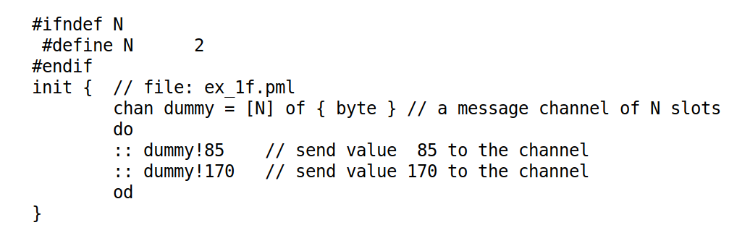
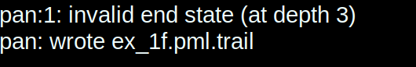
Since init never terminates

Slide 65
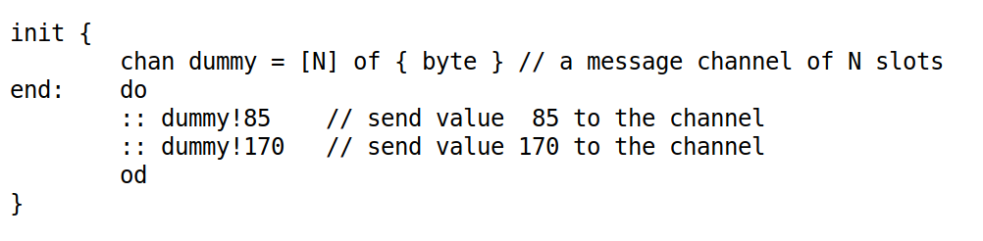
Notifies that the do loop is an on going process
Example of on going processes are monitoring guard processes

Slide 66
Progress state
A progress label states the requirement that the labeled global state must be visited infinitely often in any infinite system execution.
Any violation of this requirement can be reported by the verifier as a non-progress cycle.
EXAMPLES
active proctype dijkstra()
{ do
:: sema!p ->
progress: sema?v
od
}

Slide 67
Never {} and accept {}
Let p and q be two boolean expressions and consider the property that
``along every computation, each system state in which p is true (a p-state) is eventually followed by a q-state''
The following never claim verifies whether the property holds; i.e., it will detect any violation of the property:
never {
do
:: p -> break
:: true /* or equivalently: (p || !p) */
od;
accept:
do
:: !q
od
}

Slide 68
Mutual exclusion problem
If two or more concurrent processes execute the same code and access the same data, there is a potential problem that they may overwrite each others results and corrupt the data.
The mutual exclusion problem - problem of restricting access to a critical section in the code to a single process at a time, assuming only the indivisibility of read and write instructions.
The problem was first described by Edsger Dijkstra.

Slide 69
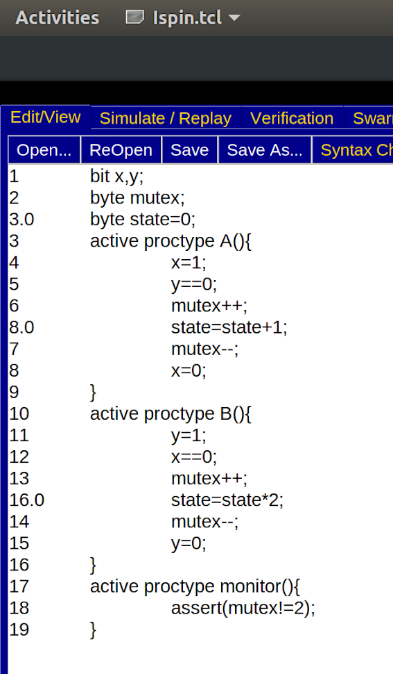
Critical section
To make sure no two mutex enter the critical section

Slide 70
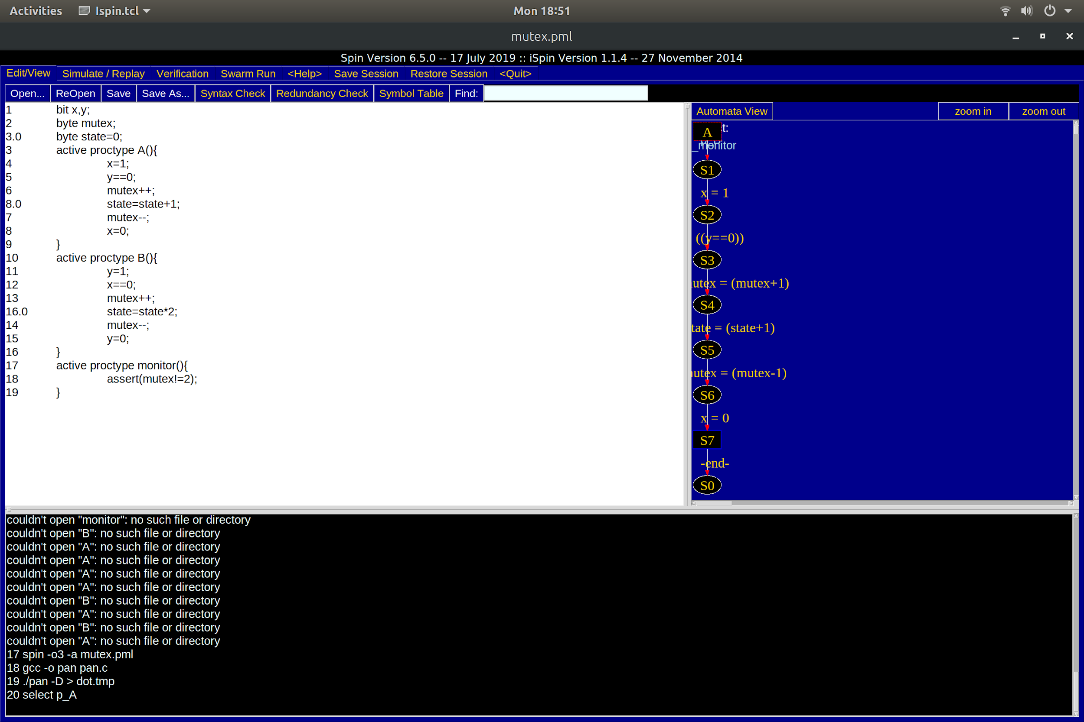
Automata views of the preocesses

Slide 71
Quick Debugging the model
Simulation run to catch errors
Specify paths, else random path simulation
Generate a verifier

Slide 72
SPIN Demo Illustration of random, interactive and guided simulation Illustration of DFS
Notes:
Pathfinder.pml

Slide 73
Two Modes of Using SPIN
1. As a Simulator
- for quick impression of system behavior:
random, interactive and guided simulation
2. As a Verifier
- to check assertions and temporal formulae
- to generate counterexample and use simulation for illustrating.

Slide 74
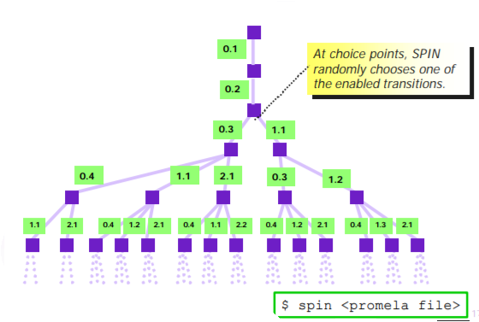
Random Simulation
In a random simulation, SPIN randomly chooses a branch at a choice point.

Slide 75
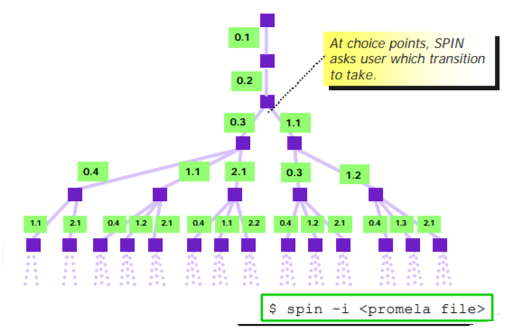
Interactive Simulation
In a guided simulation, SPIN asks the user which transition to take at a choice point.

Slide 76
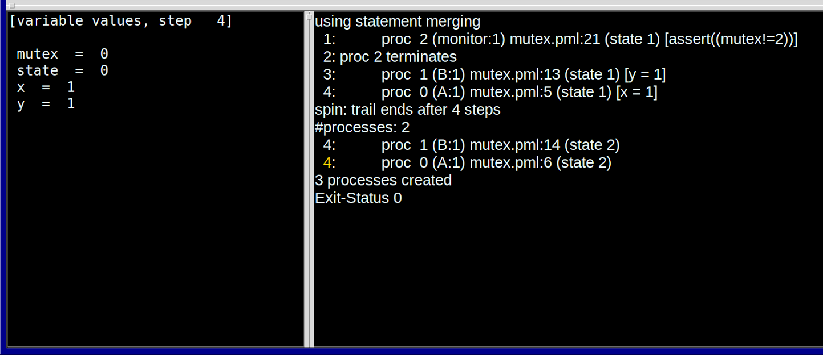
Simulation and Replay
We can change the seed to simulate on random pathways.
Here this is a WRONG mutex example since, both x and y = =1

Slide 77
On To Exhaustive Exploration…
SPIN’s random simulation - drawbacks
isn’t that useful for finding bugs
only explores one execution trace
SPIN’s interactive simulation - drawbacks
is only useful on short traces where the user already has a good idea of how a property violation might arise
only feasible to explore a few execution traces
The main strength of SPIN is its automatic exhaustive search capabilities
Exhaustive Depth First Search (DFS) , Breadth First Search (BFS)
this is why people use SPIN

Slide 78
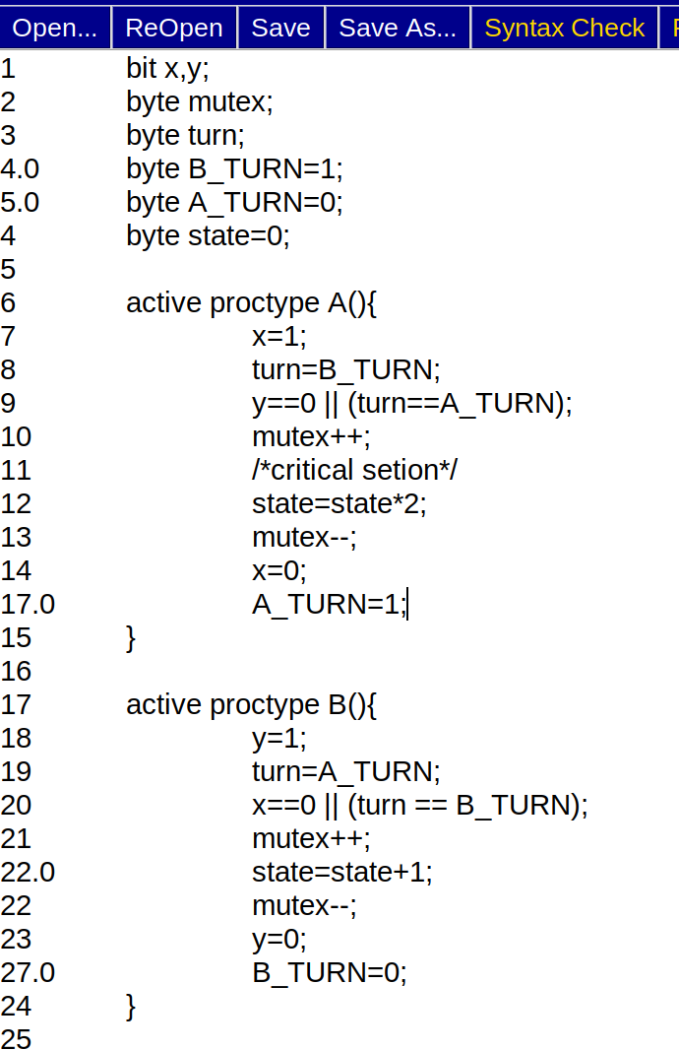
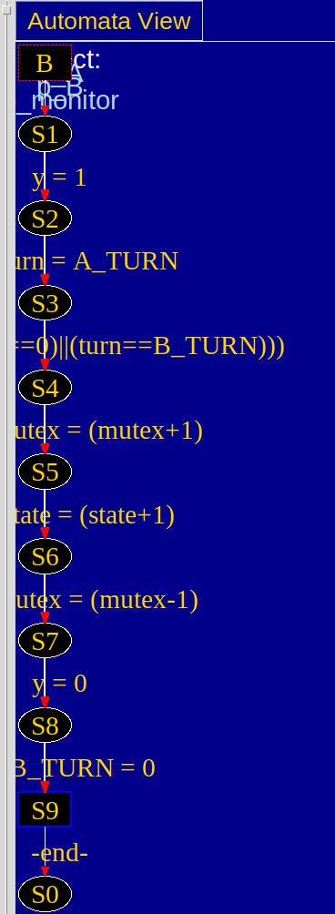
Correcting the mutex.
We add two terms, A_TURN and B_TURN. Now lets check.

Slide 79
Correcting the mutex.
Depends on the value of the other process
Condition only valid if the process if the first to enter the critical section
We add two terms, A_TURN and B_TURN. Now lets check.

Slide 80
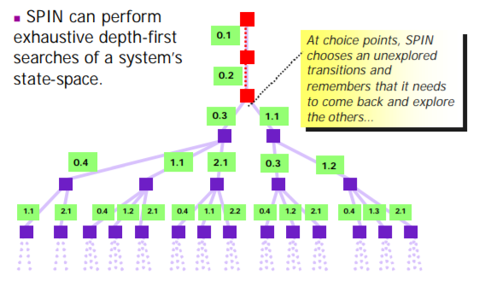
Exhaustive Depth-first Search

Slide 81
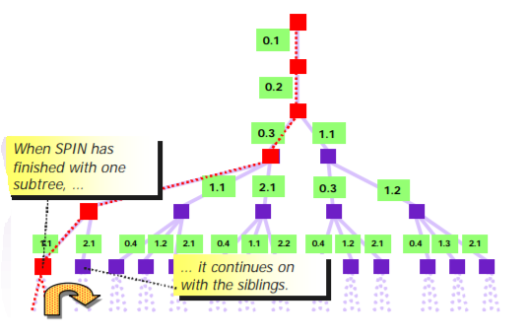
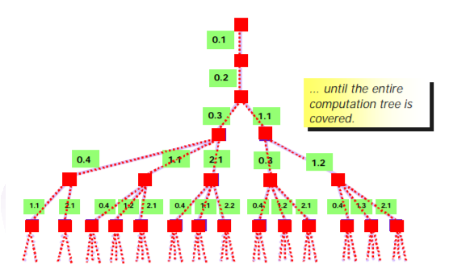

Slide 82
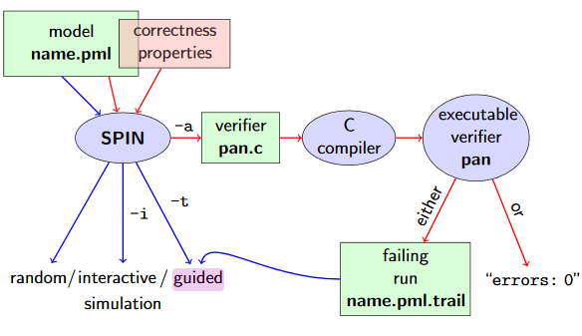
Guided Simulation - DFS

Slide 83
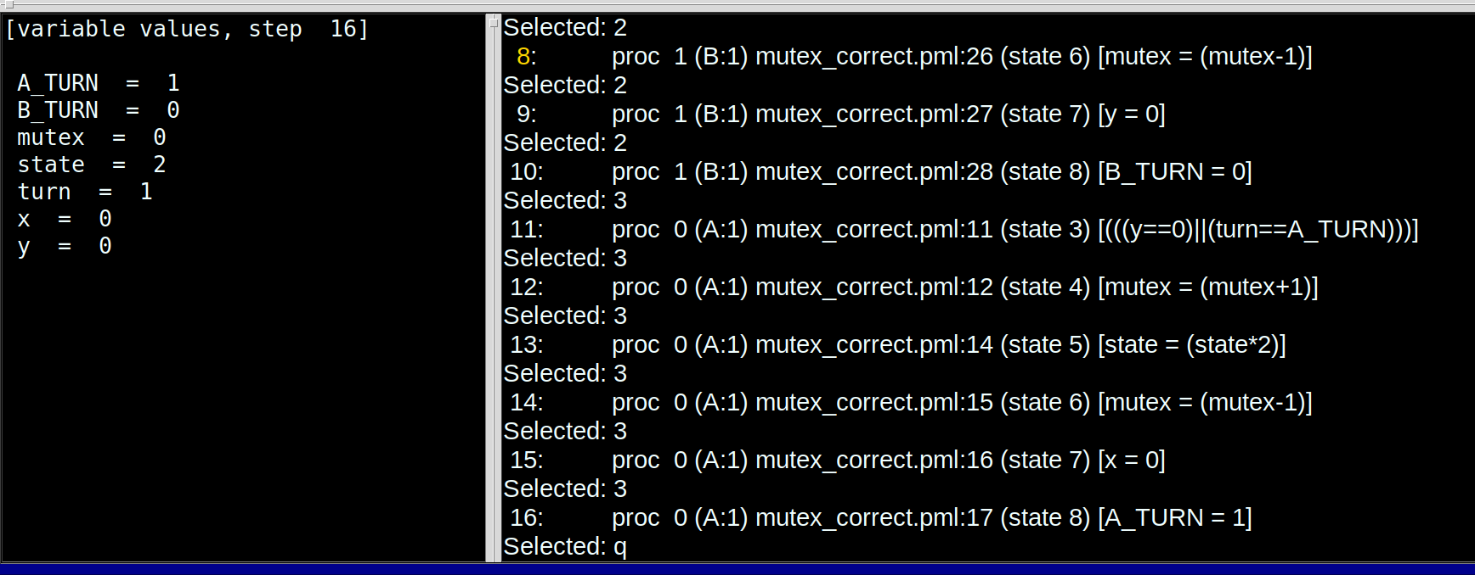
Works!
Both x and y cannot be 1 at the same time. i.e. both are accessing the critical section at the same time
The interactive simulation to allow just one process to acceshes the critical section works with this procedure. Now let’s verify it.

Slide 84
Compile the verifier
Two ways:
Affording a full trace verification
Or a super trace verification
Exhaustive verification
To optimize, use memory restriction or compression, else switch to supertrace
Supertrace verification
If full trace infeasible - due to memory limitations
Selecting the parameters
Selecting the size of hash table
Selecting the type of property to be verified (Safety/ Liveness)
Selecting the max search depth
Selecting the paramenters for a replay of error if found

Slide 85
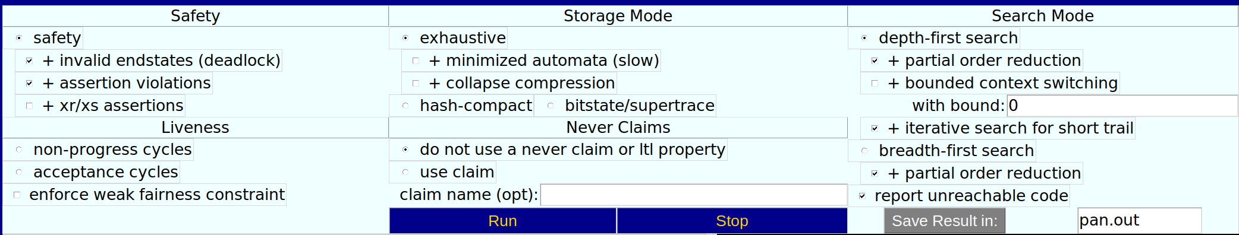
Verification checks in SPIN

Slide 86
Functionalities of SPIN
Safety:
“Nothing bad ever happens”
Deadlock freedom
the system never reaches a state where no actions are possible
SPIN: find a trace leading to the “bad” thing. If there is not such a trace, the property is satisfied.
Invalid endstates:
A state where no process makes any progress. Eg. deadlock
If it does not, we can label the state where a process is okay to stop with an end-state label.
Assertion violations:
An assert statement is similar to skip in the sense that it is always executable and has no other effect on the state of the system
If the expression evaluates to false (or, equivalently, to the integer value zero), an assertion violation is reported.
To express this, we can place the system invariant in an independently executed process, as in:
active proctype monitor()
{
assert(invariant)
}

Slide 87
Liveness:
“Something good will eventually happen”
Termination: the system will eventually terminate
SPIN: find a (infinite) loop in which the “good” thing does not happen. If there is not such a loop, the property is satisfied.
Non progress cycles
A progress label states the requirement that the labeled global state must be visited infinitely often in any infinite system execution. Any violation of this requirement can be reported by the verifier as a non-progress cycle.
active proctype dijkstra()
{ do
:: sema!p ->
progress: sema?v
od
}
Acceptance cycles
When checking for acceptance cycles, the verifier will complain if there is an execution that visits infinitely often an acceptance state.

Slide 88
Never Claim
never { sequence }
Declaration of a temporal claim that should never happen in the system being specified.
Defined as a series of propositions, or boolean expressions, on the system state that must become true in the sequence specified for the behavior of interest to be matched.

Slide 89
SPIN Demo Illustration of Petrinet
Notes:
Example 4 – Petrinet

Slide 90
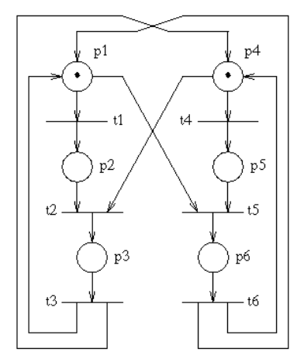
Using SPIN for Petri Net Modeling A Petri Net is a collection of directed arcs connecting places and transitions. Places may hold tokens.
(taken from the Examples website)

Slide 91
#define Place byte /* assume < 256 tokens per place */
Place p1, p2, p3;
Place p4, p5, p6;
#define inp1(x) (x>0) -> x=x-1
#define inp2(x,y) (x>0 && y>0) -> x = x-1; y=y-1
#define out1(x) x=x+1
#define out2(x,y) x=x+1; y=y+1
init {
p1 = 1; p4 = 1; /* initial marking */
do
/*t1*/ :: atomic { inp1(p1) -> out1(p2) }
/*t2*/ :: atomic { inp2(p2,p4) -> out1(p3) }
/*t3*/ :: atomic { inp1(p3) -> out2(p1,p4) }
/*t4*/ :: atomic { inp1(p4) -> out1(p5) }
/*t5*/ :: atomic { inp2(p1,p5) -> out1(p6) }
/*t6*/ :: atomic { inp1(p6) -> out2(p4,p1) }
od
}
P
R
O
M
E
L
A
D
E F I
N
I
T
I
O
N

Slide 92
States of the System
P1,P4
P2,P4
P1,P5
P3
P6
P2, P5
Blocked State!

Slide 93
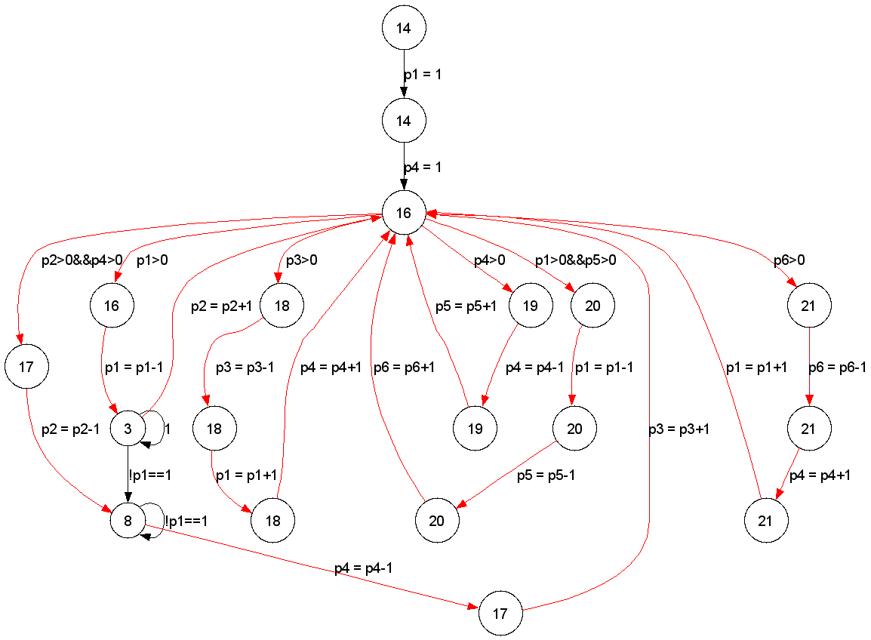
Petrinet Automata

Slide 94
Elevator System Problem
Description
Modeling of an elevator system and verification of safety and fairness properties, over the model.
There are five process types in this system:
Elevator controller
Elevator
Floor Buttons
Elevator Buttons
Process to record button presses
The elevator controller uses the Elevator Algorithm.
The Elevator controller communicates its instructions to the Elevator, over a channel of size 0, to ensure handshaking of the two processes.
The Floor Buttons and the Elevator Buttons also communicate the button presses to the process recording the button presses, over a channel of size 0, to ensure handshaking.
The model assumes that every floor has only one button, to call the elevator to that floor. Whether to go Up or Down is decided once the elevator doors open, on the floor.
When no requests are to be serviced, the elevator stays idle, with its doors open.

Slide 95
LTL Properties specification
1. Current floor number always stays between 0 and 2
ltl valid_range
{ [] (curr_floor >= 0 && curr_floor <= 2)}
2. The elevator never moves with its doors open
ltl door_closed_in_motion
{[](!(door_state == 1 && (elevator_controller[0]@upward_motion || elevator_controller[0]@downward_motion)))}
3. Requests to use the elevator are eventually serviced
ltl elevator_use_serviced
{[](((floor_switch[0] == 1) -> <> (curr_floor == 0 && elevator_controller[0]@start)) &&
((floor_switch[1] == 1) -> <> (curr_floor == 1 && elevator_controller[0]@start)) &&
((floor_switch[2] == 1) -> <> (curr_floor == 2 && elevator_controller[0]@start)))}
4. Requests to be delivered to a particular floor are eventually serviced
ltl floor_reach_serviced
{[](((lift_switch[0] == 1) -> <> (curr_floor == 0 && elevator_controller[0]@start)) &&
((lift_switch[1] == 1) -> <> (curr_floor == 1 && elevator_controller[0]@start)) &&
((lift_switch[2] == 1) -> <> (curr_floor == 2 && elevator_controller[0]@start)))}
((lift_switch[2] == 1) -> <> (curr_floor == 2 && elevator_controller[0]@start)))}

Slide 96
References
http://www.cs.cmu.edu/~emc/15-398/lectures/overview.pdf
https://www.embedded.com/an-introduction-to-model-checking/**
https://members.loria.fr/SMerz/papers/mc-tutorial.pdf
http://netlib.bell-labs.com/netlib/spin/whatispin.html
http://spinroot.com/spin/Man/1_Exercises.html**
http://www.cs.cmu.edu/~emc/15-398/lectures/spin-1.pdf**
http://spinroot.com/spin/what.html
http://spinroot.com/spin/Doc/p40-ben-ari.pdf
http://spinroot.com/spin/Doc/ieee97.pdf
http://spinroot.com/spin/Doc/SpinTutorial.pdf
https://courses.cs.washington.edu/courses/csep590/03su/Lectures/Promela.html
http://spinroot.com/spin/Man/Manual.html (Contentful and explained promela programs)
http://spinroot.com/spin/symposia/ws02/ruys_abs.pdf (Conceptual problems in programs which can be detected by SPIN, Contentful paper)
http://spinroot.com/spin/Man/Roadmap.html(BUILDING AND VERIFYING Spin MODELS
http://spinroot.com/spin/Man/Pan.html** Outputs explained
http://spinroot.com/spin/Doc/SpinIntro.pdf** ( DFS BFS Explained simply)
https://github.com/vaibhavbhagee/Distributed-Computing/blob/master/Assignment-1/elevator-system/elevator-system.pml
https://www.geeksforgeeks.org/semaphores-in-process-synchronization/

